Slide 1
Housing Mediation Services
Presented by Deborah Jordan and Deb Redlich

Slide 2
Agenda
2
Conflict can escalate
Conflict styles
Conflict outcomes
What is mediation and why mediate
Examples of conflicts
Housing Mediation Services
Questions, Comments and (hopefully) Answers

Slide 3
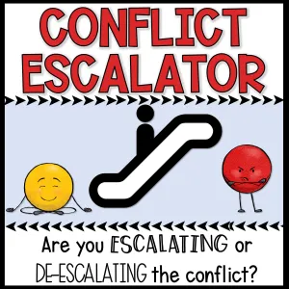

Slide 4


Slide 5
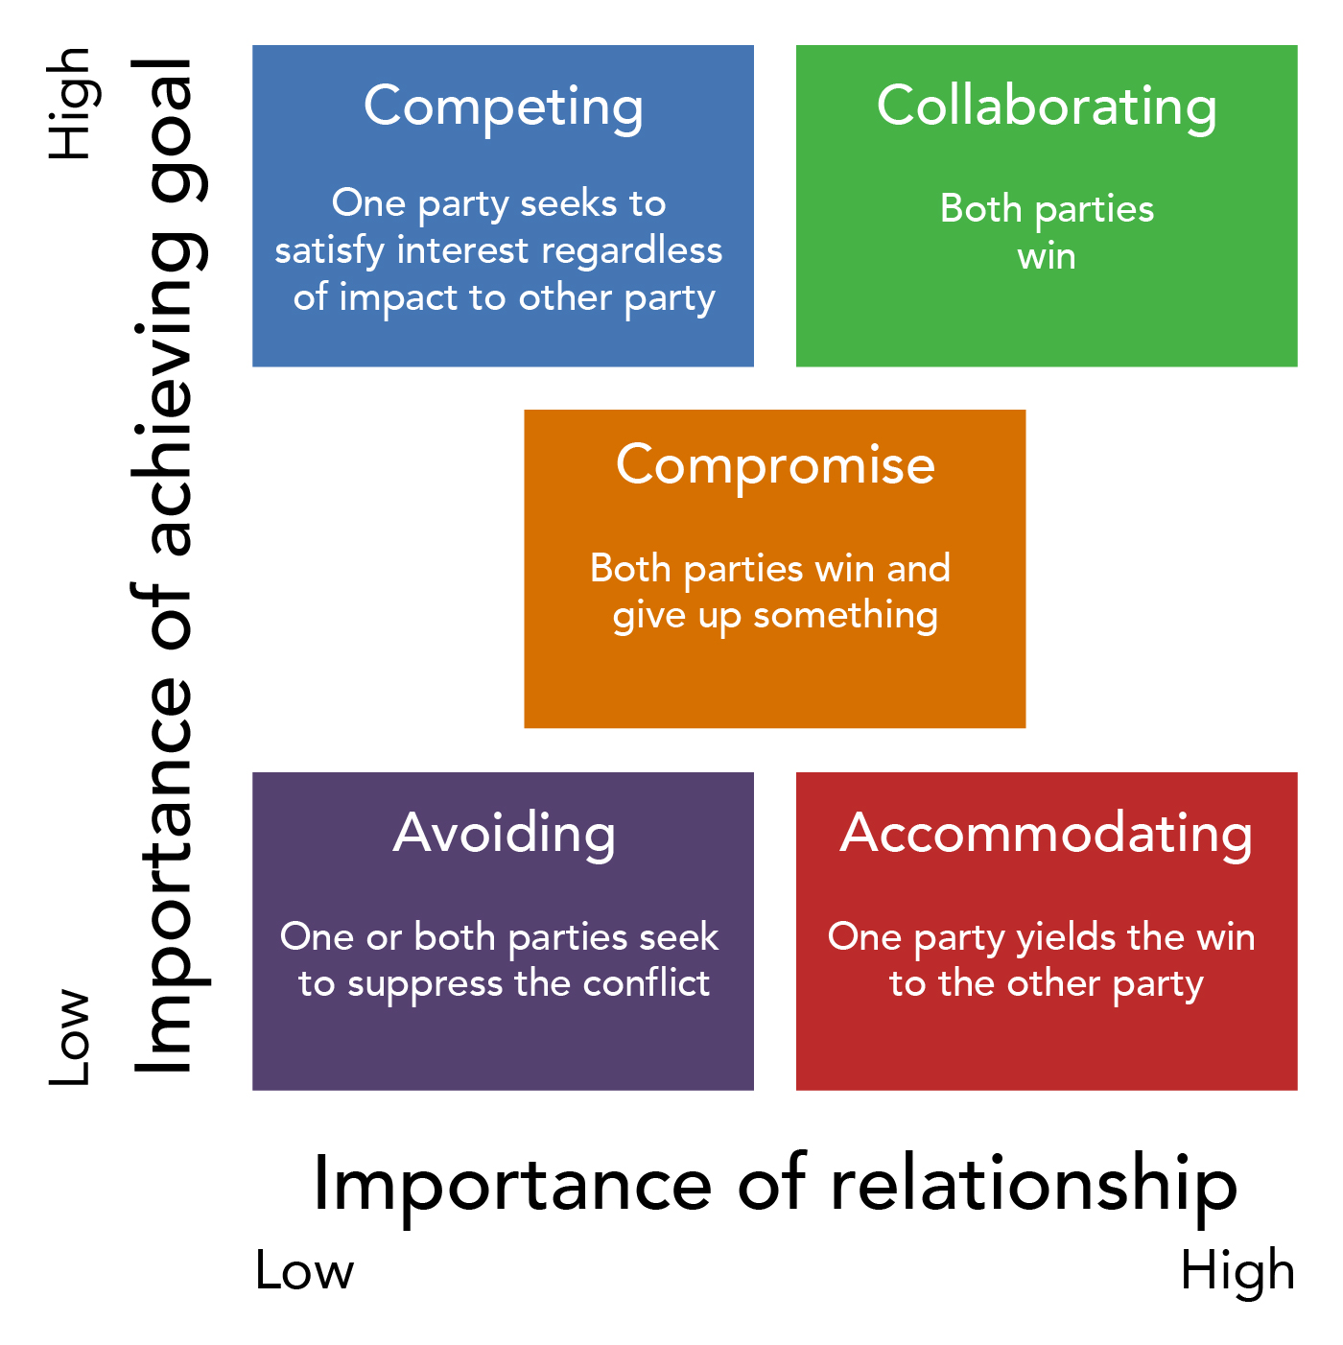
Conflict styles

Slide 6
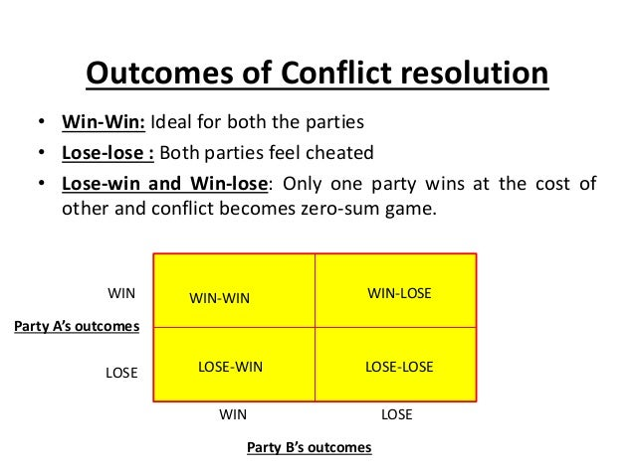

Slide 7

What is mediation?
7
A respectful space for parties to work together to resolve their conflict with a third neutral party (mediator) guiding them through a process to come to better understanding and a mutually agreeable solution.

Slide 8
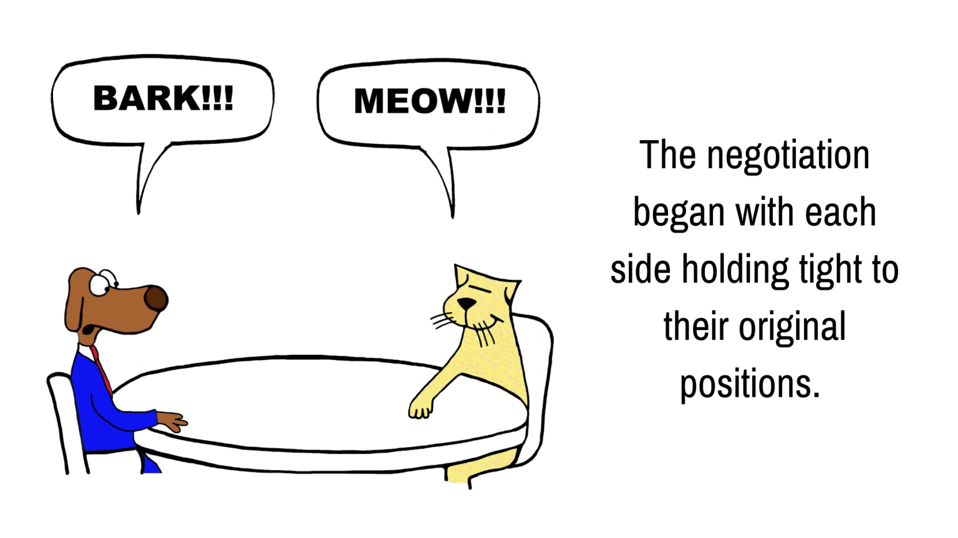
What is mediation? – Finding common interests
8

Slide 9
The Mediation Process
9
Introduction and Groundrules (including confidentiality
Tell the mediator what happened while the other person listens
Understand the situation and brainstorm solutions
Come up with a mutually agreeable solution to prevent further problems
We meet in an agreed upon private space. The process typically takes 1 to 2 hours.

Slide 10
Why mediate?
10
Enhances communication – through established ground rules and a neutral third party (mediator) guiding the discussion.
The process remains confidential.
Participants in the conflict have control over the resolution.
Solutions that are mutually accepted can often be more innovative than those mandated by a court.
Scheduling tends to occur more rapidly than through court referrals.
Approximately 85% to 90% of mediations end in an agreement.
Thanks to our sponsors, our services are provided at no cost.

Slide 11
Examples of housing-related conflicts
11
Money for rent, late fees
Repairs
Bedbugs
Noise complaints
Children fighting or damaging property
Visitors
Mutual terminations
Pets
Parking
Trash

Slide 12

Housing Mediation Services

Slide 13

Mediation- an important choice
"The courts of this country should not be the places where resolution of disputes begins. They should be the places where the disputes end after alternative methods of resolving disputes have been considered and tried." ~ Sandra Day O'Connor, Supreme Court Justice (1981-2006)

Slide 14
Questions, Comments?
Website: HousingMediation.org
Funded by:
Greater Cincinnati Northern KY Apartment Association
Housing Opportunities Made Equal (HOME)
Real Estate Investors Association (REIA)

